Slide 1

Power Point for zero to hero !
Welcome to Power Point
Design principles
on slides
Headline
bullets
Say it
graphically !
Highlight
information
Animation
& speaker behavior
PROJECT
DAY 1
DAY 2
DAY 3
DAY 4
DAY 5
DAY 6
WEEK END

Slide 2
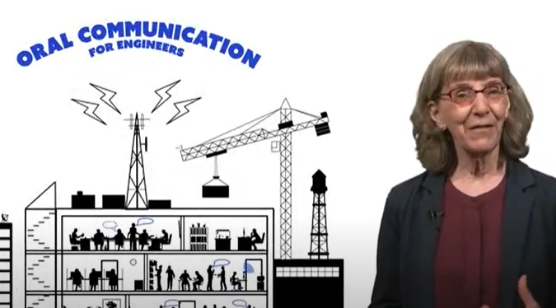
BEFORE THIS SESSION
You should have watched the below 2 videos (part 1 and part 2)
https://drive.google.com/drive/folders/1kEWEqQGKujuCVrr3TSr6h-FvX2j0BsFA?usp=drive_fs

Slide 3


OBJECTIVES FOR TODAY
4 rules for riding your bicycle safely
Write
efficient BULLETS
Write
efficient HEADLINES
1
2
Watch for other cars
Obey the traffic signs
3
4
Be aware of scooters
Wear a helmet

Slide 4

What is the most important part of your presentation ?
1 - You
2– The slides
3 – Your audience

Slide 5
What is the most important part of your presentation ?
1 - You
2– The slides
3 – Your audience
Notes:
Your slides are NOT the most important part of your presentation.
The spotlight should always be on you and what you say
Your slides should be lean and clean, so they integrate nicely with your oral content.

Slide 6
You slides are made for …
1 – For the speaker, to remember what to say
2– For my audience, to help them to understand my ideas
3 – For my audience, to know all about the topic I am presenting

Slide 7
You slides are made for …
1 – For the speaker, to remember what to say
2– For my audience, to help them to understand my ideas
3 – For my audience, to know all about the topic I am presenting
Notes:
A common mistake that many presenters make is to create slides they want to use as a script.
They're afraid of forgetting something, so they put as much content as possible on each slide to remind themselves what to say.
Keep in mind that the slides are for your audience, not for you.
The slides are there to help your audience understand and remember your key points.

Slide 8
What is the first thing the audience see on a slide?
1 – The heading
2– The bullets
3 – The graphics
4 – The slide number

Slide 9
What is the first thing the audience see on a slide?
1 – The heading
2– The bullets
3 – The graphics
4 – The slide number
Notes:
The heading of your slide is usually the first thing your audience sees.
That makes it a very powerful component of your presentation.
You can use slide headings to help your audience understand your topic by making them more specific than generic.

Slide 10

EXPLAIN
Why most people
write bad slides ?
# REASON1
They don’t write strong headlines

Slide 11



EXPLAIN
What is a bad headline?
5 MIN
Too generic
Can be applied to any other topic
Just say what is your solution !
Solutions of this problem
Not unique
don't really tell anything useful
Notes:
Make few students try in front of the class

Slide 12
EXPLAIN
How to write a good heading ?
5 MIN
Use active language
Make a point
Top five trends that impact your business
Specific
Interesting
clear and concise
Notes:
Make few students try in front of the class

Slide 13


EXPLAIN
Strong headlines
Weak headlines
Company history
Our products
Pokémon game
How our new technology is transforming the industry
Why our company is the best choice for your needs
Pokémon game is the best game EVER

Slide 14

DISCUSS
Find better headlines !
30 MIN
CASE 1
CASE 3
Speech topic:
Analysis of the impact of sun on health
Speech topic:
Present Telegram application
Weak headline:
Results
Weak headline:
Benefits of Telegram
Strong headline
??
Strong headline
??
CASE 2
CASE 4
Speech topic:
Presentation of an English project
Speech topic:
Convince audience to use bicycle
Weak headline:
What I have learned from this project
Weak headline:
Impacts of using bicycle on your health
Strong headline
??
Strong headline
??

Slide 15
EXPLAIN
Why most people
write bad slides ?
# REASON2
They don’t write good bullets

Slide 16
EXPLAIN
Bullets should be clear and concise
They capture key ideas in just a few words.
They are like the notes your audience could take
You should continue to develop your skill all your life, during your work and your free time,
Develop your skills all your life
1 line per bullet

Slide 17
EXPLAIN
Bullets should have the same structure
Start with a verb or start with an adjective
Develop your skills
Organizing time
Efficient Notetaking
Develop your skills
Organize your time
Write notes
Verb but different format

Slide 18
ATIVITY
Analyze those headline and bullets !
10 MIN
GOOD HEADLINE
Use active language
Specific
Make a point
Interesting
clear and concise
GOOD BULLETS
1 line per bullet
2 to 6 bullet max per slide
Same structure
4 rules for riding your bicycle safely
1
2
Watch for other cars
Obey the traffic signs
3
4
Be aware of scooters
Wear a helmet

Slide 19
ATIVITY
Find the best headlines and bullets !
30 MIN
THE TEXT
YOUR HEADLINE
Climate change is a big problem that affects the whole world. It happens because people release gases that make the Earth hotter. When the Earth gets hotter, the ice at the North and South Poles melts, and the oceans get higher. Climate change also makes the weather very extreme, like really hot days, strong storms, and not enough rain. It's also causing many animals and plants to disappear forever..
YOUR BULLETS

Slide 20
SOLUTION
Find the best headlines and bullets !
THE TEXT
YOUR HEADLINE
Climate change is a big problem that affects the whole world. It happens because people release gases that make the Earth hotter. When the Earth gets hotter, the ice at the North and South Poles melts, and the oceans get higher. Climate change also makes the weather very extreme, like really hot days, strong storms, and not enough rain. It's also causing many animals and plants to disappear forever..
3 reason why climate affects the world
YOUR BULLETS
Climate change...
Is due to human who release gases
Makes the oceans higher.
Makes animals and plants disappear

Slide 21
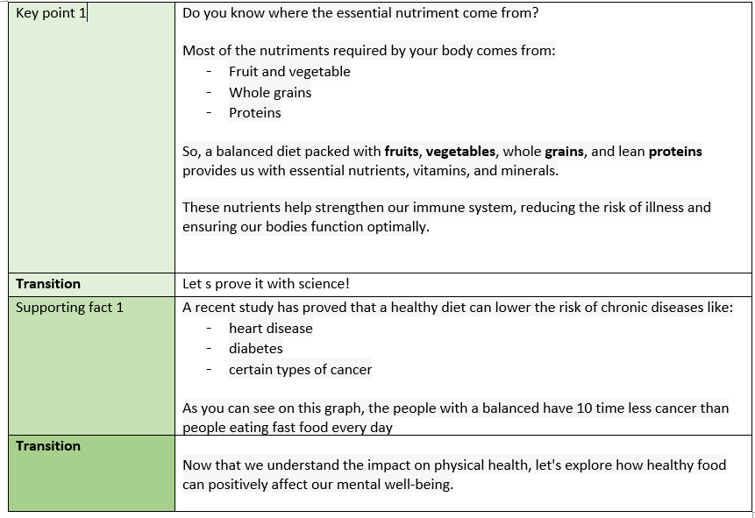
FOR NEXT TIME
Focus the first KEY POINT of the Healthy food speech :
How many slides do you need ?
For each slide find : the headline and bullets

